Slide 1

POL 2012: Theories and Models in Political Economy
Economic systems
Classical and neoclassical economics
Espen Moe
Department of Sociology and Political Science
espen.moe@ntnu.no, #9587, 73592230

Slide 2
Economic systems
The nature of economic enquiry
Economic performance, economic progress
What is capitalism?
Economic theories (and theories in general)
Classical economics
Neoclassical economics

Slide 3
The nature of economic enquiry
Distinction economics – political economy?
Broader view of economic enquiry
Social purpose and political application
Material economic concerns
Never wholly value free
Makes values explicit, not masking them
Evolutionary processes rather than equilibrium
Equity and sustainability as well as efficiency
Institutions
Social character of economic activity

Slide 4
Economy and society: 7 dimensions
Nature
Markets
State
Class
Gender and ethnicity
Social capital
Ideology

Slide 5
Economic performance, economic progress
Evaluating economic performance
Efficiency
Equity
Sustainability
Compatibility with social goals
How do we measure economic progress?
GDP(?)
Sum of the market value of all goods and services in a country during a year
BUT:
Domestic work, luxury items, car crashes, pollution control devices, running down natural resources
Suits manufacturing, not services.
«In Greece, statistics is a combat sport»
Notes:
Efficiency, equity, sustainability, compatibility with social goals.
Sometimes forgetting that there are more goals than economic efficiency (or that efficiency might be improved by prioritizing other goals). Economic efficiency seems value-neutral, unlike all the others. By all means, not a bad measure, but it has biases..! (As does every measure) [NOT a big conspiracy. Not been deliberately sidetracked by the government or by capitalists, or by economists, etc.]
Efficiency: Makes the N economy better than many others. Well regulated, well ordered, and economist in every department see to it that there is only so much waste that you can get away with. Hard in Norway to seriously abuse funding and privileges. But waste: What is wasteful? Planned obsolescence? 1) resource utilization, 2) efficiency of resource allocation, 3) efficiency of resource creation
Equity: = fairness. Equal income for all? Equal opportunity? Should the state actively correct for inequalities as poverty, class, ethnicity, gender? Or should it just see to it that no one is actively discriminated against? Taxes? Progressive tax? Or flat tax without loopholes?
Sustainability: ability of the system to reproduce itself; Economy vs. physical environment; Chinese growth, how impressive is it really? Economists: Polluter pays? But that only works if the goal is to find the “right” amount of pollution, not if the goal is to eliminate pollution…! Pick the lowest hanging apples first, or pick them all? Pick the right amount of apples? At the same time, creates powerful individual incentives to alter behavior.
Compatibility with social goals: The ultimate test. But how about if social goals and sustainability clash? Sustainability as the ultimate test?
What is progress?
GDP? Sum of the market value of all goods and services produced in a country during a year.
Diane Coyle on how statistical analysis a sport in Greece (or something): In Greece, statistics is a combat sport.
Guest lecture (probably) later on which will talk about this in detail. Many problems with GDP.
Domestic work, luxury items, car crashes, pollution control devices, rundown of natural resources (oil: income or [drawing down of our] fortune/wealth?)
And far more suited to a world that consists of manufacturing. Far harder to measure market value in services. [Coyle]
Also, only goes back to the 1920s.
William Easterly
Other indicators? Health. Cuba. But is it sustainable? Even reducing economic growth because all the resources are poured into one area, prioritizing one indicator?
Primacy of GDP:
Overemphasis on growth at the expense of the planet? (Environmentalists)
Overemphasis on growth at the expense of happiness? Well-being not measured by GDP!
When did we get GDP?
1665, early English estimates of income, expenditure, population, land ++ of England and Wales. Why? To find out what the resources of the country was and if it could afford to finance a war against the Dutch. (1664-67). Could England bear a higher burden of taxes? Impossible to know if you have no data…!
As late as the 18th c, no national budget in France. Very loose notions of whether incomes matched expenditures. Attempt at creating a budget in 1781. but bad budgeting part of the reason why UK, with less than half the population could raise as much in taxes as F. And pay half the interest rate on its loans.
Comparing SU and US growth. Not comparable statistics!
Present-day Chinese growth? Can we trust the figures?
Ireland, suddenly adjusted up by 25%
Ghana, up by 60% in November 2010!
And these are important figures! Determines the rate at which you can borrow money. Determines whether or not politicians get reelected.
Silicon Valley: How do you measure the economic growth from internet connectivity or mobile telephones, mobile cameras. Quality of the products keep increasing while the price stays the same. How do we measure services? Especially hard with public services. Wages paid? Then, how do you measure productivity?!
Productive vs unproductive activity? SU statistics counted material output and ignored the services. But today services account for at least 2/3 of the economy! Legacy of the 19th c.
Modern GDP, UK, 1920s-30s attempts at calculating national income and expenditures. US, FDR wanted a clearer picture of the state of the economy in the depression. 1934 report, US national income halved between 1929 and 1932. Probably not correct by today’s accounting standards though! But before this, we only had industrial statistics.
Need for a measurement that was useful for govt to run the economy/fiscal policy.
First US GNP statistics, published in 1942.
Not at all obvious what would go into the GNP/GDP. Something that economists were discussing intensely.
Also, a consequence of the fact that the economy is no longer only the private sector. Govt finally becoming important in everyday lives.

Slide 6
Capitalism
The predominant system of economic organization
Alternative systems: Communalism, slavery, feudalism, socialism
What makes capitalism different?
Dominated by financial considerations
Control over capital the key source of power
Financial reward/profit as the end goal
Wage work
Primacy of pecuniary relationships

Slide 7
What is capitalism? Definition?
Cluster of interconnected characteristics
Private ownership
Labor market
Capital market
Land market
Markets for goods and services
Distinctive role for the state
Distinctive ideology
Expansionary tendency

Slide 8
Economic theories (and a little philosophy of science)
What is a theory?
What is a (economic) model?
Why do we need them?
(What happens if we don’t have theories…?)
Where do they come from?
Competing schools of thought
Scientific paradigms
Kuhn
Economic paradigms
Stubbornly persistent!
The world changes, the theories persist!
(Why?)

Slide 9
Economic theories
Early capitalism
Classical political economy
Adam Smith (and others)
→ Neoclassical
Marxist economics
Different reformist perspectives
Keynesian economics
Institutionalists
In all shapes and sizes…
Post-war orthodoxy: Keynesian-neoclassic blend
Monetarism and return to free-market economics
«Modern political economy»
Notes:
Not sure about the arrows… [NB: dotted lines are discontinuities!] And no evolutionary economics (obviously).
Starting point: late 18th c. Capitalism emerging from feudalism. [Although McCloskey…] Adam Smith. Development of classical political economy. Emergence of specifically capitalist economics.
Neoclassical from the classical. Formal modeling of equilibrium conditions in competitive markets. Economics on a more scientific basis.
Marxist economics. Very different interpretation of capitalism. → economic inequality, social conflict, periodic crises. Only a fundamental transformation of the political economic system will reconcile economic concerns with social justice and progress. Focus much more on justice than efficiency.
Reformist perspectives. Keynes. Institutional tradition. Not coming out of the neoclassical. Focus on what govt can and should do. Institutional, from Thorstein Veblen. Welfare state. [NEED MORE! Not very good!] Keynes. Persistent unemployment. Capitalism as morally objectionable, but better than the alternatives… Economic policy to reduce unemployment, understanding unemployment. Makes the state central and far more activist. Hobsbawm: Saving the essentials of capitalism by inscribing it in a strong and interventionist state.
Post-war orthodoxy, neoclassical synthesis. Keynesian macroeconomics and neoclassical microeconomics. Keynes taking a hit in the 1970s-80s. Instead monetarism. Return to free-market economics. Releasing capitalism from the constraints of trade unions and govt interventions.
“Modern political economy”. Profound reservations. Neoliberal fails to provide coherent means of understanding contemporary capitalism. Policy prescriptions accentuate inequality, instability and insecurity.

Slide 10
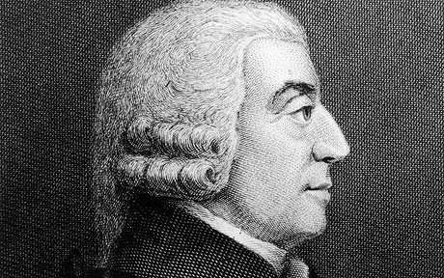
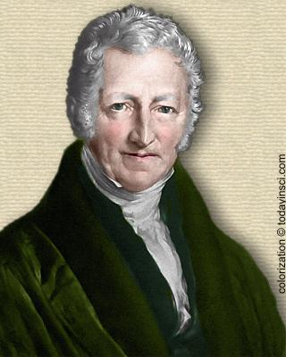
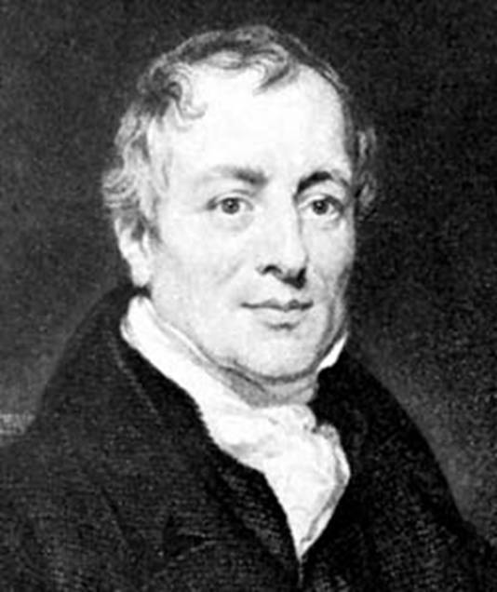
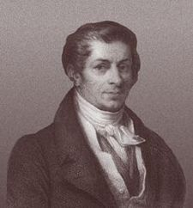
The classical economists
Adam Smith (1723-90)
Freedom of exchange
Self-regulating markets
Invisible hand
David Ricardo (1772-1823)
Comparative advantage
Thomas Malthus (1766-1834)
Demography vs. food production
Jean-Baptiste Say (1767-1832)
Say’s Law: Supply creates its own demand
No economic recession from shortages in demand

Slide 11
Theory of comparative advantage
Hours of work necessary to produce one unit
Country | Cloth | Wine
England | 100 | 120
Portugal | 90 | 80

Slide 12
The epoch. What makes it special?
The start of capitalism?
From merchant capitalism to industrial capitalism?
Capitalism + structural change(s)
Agricultural revolution
Industrial revolution
Ideological revolution?

Slide 13
Common themes
Value
Value in use vs. value in exchange
Value reflecting the costs of production
Labor theory of value
‘Natural price’
BUT: No longer ‘just price’
Distribution
Distribution among classes (capitalists, landowners, workers)
Naturalness of the class system
Wages naturally tend towards subsistence level
BUT: Not income distribution, just distribution. No ‘just’ distribution, but natural distribution.
John Stuart Mill (1806-73)
Distribution of wealth decided by laws and customs of society (≠ Malthus!)
Growth

Slide 14
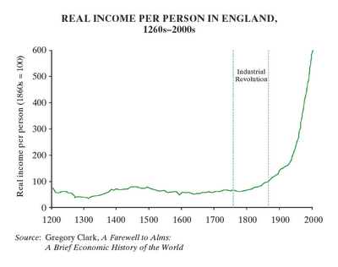
Different types of growth (Stilwell (and Mokyr))
Accumulation of capital/Solovian growth
Expansion of trade/Smithian growth
Division of labor/Smithan growth
Scale effects, scope effects
Schumpeterian growth?!?
Growth based on human
capital, innovation,
technological progress
Why is it not included?!

Slide 15
Importance of land
Different: Supply inherently limited
Natural resource endowment
Different takes on land
Custodians (indigenous communities)
Feudalism
Landowners defining the economic/political/social order
Ruling class rules because it controls the land
Classical political economists
Transition period
Landowners still dominating parliament
«Capitalists» becoming economically dominant
Free trade or protection?
Corn Laws

Slide 16
From classical to neoclassical
Similarities
Pro-capitalist
Markets as key to mutually advantageous exchanges
Markets ensuring the efficient allocation of resources
Attempt at discovering the laws of motion in economic life
Newtonian ideal, «physics envy»
Self-regulating system
Self-interest as the moving force
Desirability of private property
Skepticism against the ‘visible hand’ of the state
Economic liberalism

Slide 17
From classical to neoclassical
Differences
Classicists far more holistic
Economics included history, geography, politics, institutions, social sciences in general
Concerns of social progress
Neoclassical economics detached from the other social sciences (and from moral philosophy)
Analytical, scientific, mathematical, lots of «physics envy!»!
Exchange relations
No focus on production, growth, distribution, accumulation, crises
Price system and market competition
Supply and demand
Labor important only as factor of production, shaping the price
Utility
Maximizing of personal utility

Slide 18
Assumptions
Generality
Supply and demand always holds
Markets tend towards equilibrium
Marginal analysis
Focus on incremental adjustments
Consumer taste taken as given
Distribution of income as given
Technology as given
Bias?
Incrementalism
Market as neutral problem solver, price system as science
No room for class struggles or revolutions (or financial crises)
Tending towards social Darwinism?

Slide 19
Why does it happen?
Historical epoch
Capitalism deeply threatened – neoclassical economics does NOT seem like the answer!
Social turmoil
Socialism/Marxism
Economic depression
Imperialism
Invisible hand sounds better than iron fist of imperialism
Scientifc! Objective! Neutral!
Need for an antidote to Marx
Novel solution to new conceptual problems
Utilitarian philosophical influence (Jeremy Bentham)
Economics as separate from other social sciences
Scientific!

Slide 20
Contributors/contributions
Léon Walras (1834-1910)
General equilibrium theory
Interaction of supply and demand resulting in an overall equilibrium
William Stanley Jevons (1835-82); Carl Menger (1840-1921)
Marginal analysis
Alfred Marshall (1842-1924)
Making economics scientific
Mathematics as an aid (but not the main thing!)
Detaching economics from moral philosophy
Supply and demand
Utility, utility maximization
Goods have no inherent value, independently of the consumer
Behavior of individuals and competitive markets
Consumer demand affecting prices and resource allocation
No room for classes, competing interests, social progress

Slide 21
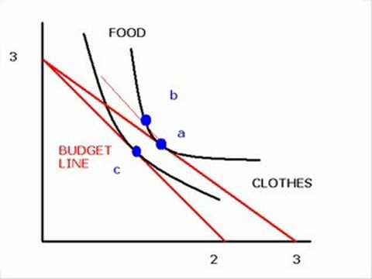
Consumers, firms
Consumers
Utility max, consumer rationality, consumer sovereignty
Uniform objective: Attain highest possible utility for a given disposable income
Rationality = ?
Indifference curves
Consumer is king…
Firms
Profit maximization as the universal goal
Output such that marginal cost = marginal revenue
Fundamentally passive. Responds to conditions.
Assumptions: The firm knows 1) production function, 2) price of factors of production, 3) market demand for products
Economic efficiency when free enterprise

Slide 22
Market structures
Perfect competition
Ideal? Not for the firm!
Analytical elegance over practical relevance!
Maximum efficiency in the use of factors of production
Elimination of excess profits
Continuous adjustment of market prices to changes in conditions
Monopolistic competition
Oligopoly
Brand names and differentiated products
Monopoly
Resource allocation, not creation
Trust-busting
What structure is better for long-term economic growth?

Slide 23
Distribution
Neoclassicists: Political question, not economic
Pareto: inequality in income distribution reflects inequalities in human ability = natural
Taking distribution as a given. Economist’s task: what shapes the pattern of factor prices.
Productivity? Marginal productivities determine distribution
Bias:
Leave distribution questions alone
Will impair the efficiency of the market
Don’t screw with the price system!
Economic disparities as a necessity
Ignores:
Role of economic power in shaping factor prices
Power plays, negotiations, vested interests

Slide 24
Welfare economics
Economics as a value-free analysis, positive economics… But…
Bridge between what is and what ought to be
Progressive taxation/redistribution arguments from marginal utility reasoning
Pareto optimality
Market failure
Public choice theory
Has it been a success?

Slide 25
Conclusions
Neoclassical economics an obvious relative of classical economics
Ideologically close
BUT:
Become much narrower, and not preoccupied with issues that cannot be solved economically. Attempt at becoming a value-free (hard) science.
From political economy to economics…
Utility, equilibrium, individual (firms, consumers) maximizers
Gone from production to exchange
Value-free?

